Slide 1

Lucien ledune – oscar liessens

Slide 2
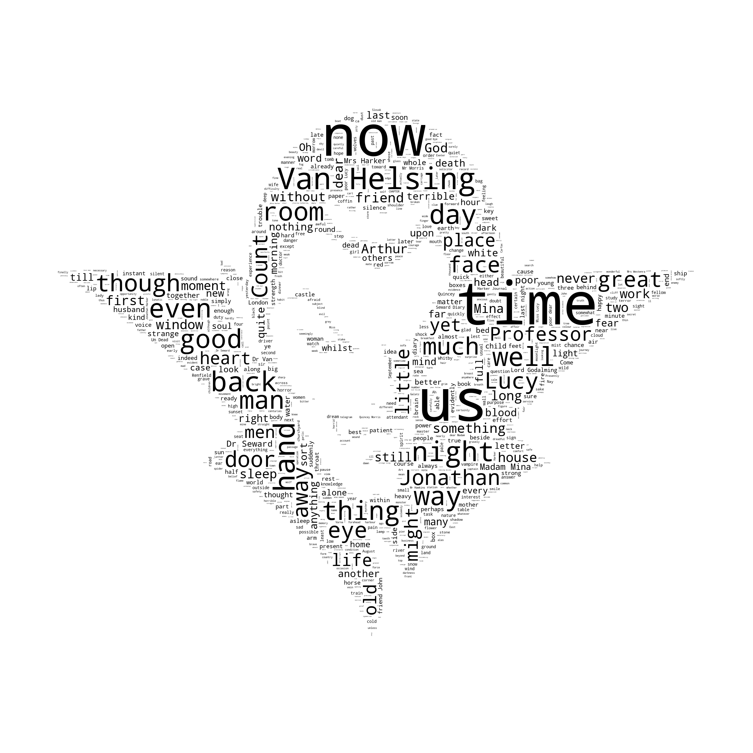
Introduction
Dracula : a masterpiece novel of the gothic horror genre
Synopsis : a perfect couple, some soldiers and scientists, and a malevolent tourist
An epistolary style
Reasons for this choice

Slide 3
Introduction
Text preprocessing
Topic extraction:
LDA
NMF
Relationships graph
Frequent itemsets
Bonus : a search engine
Conclusion

Slide 4
Text pre-processing
Only keep chapters in the txt file. (Remove unnecessary parts before and after the book)
Divisions : Chapters/N sentences
Lowercase
Remove punctuation and special characters
Stemming of the words : reduce to its root form

Slide 5
Topic Extraction
First extract topics for all chapters
Then extract one topic from each chapter, trying to get the differences in topics and see the story progression

Slide 6

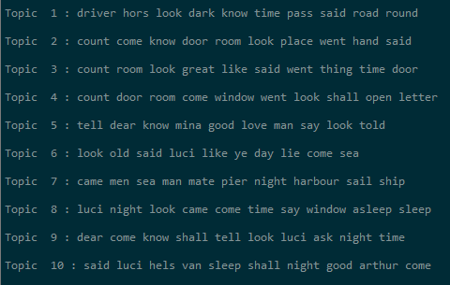
Topic extraction : LDA
Full text extraction :
Chapters Extraction (LDA) :
First chapter example : Jonathan travels to meet Count Dracula, travels in a coach with a driver

Slide 7
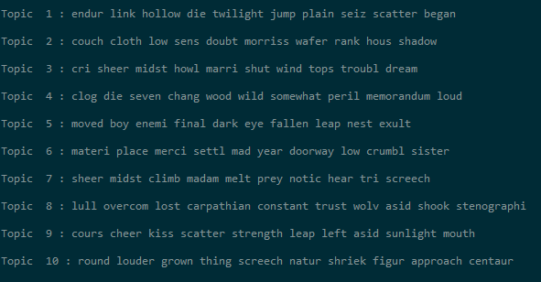
Topic extraction : NMF
Another algorithm often used for topix extraction is NMF, we use it to extract topics from chapters

Slide 8
Relationship graphs
We want to have a better understanding of the relationships between main characters in the book.
We generate an adjacency matrix from the book, checking how many times characters are mentionned together.
We use this to generate a graph of the book relationships
Then use pagerank to determine a ranking between characters.

Slide 9
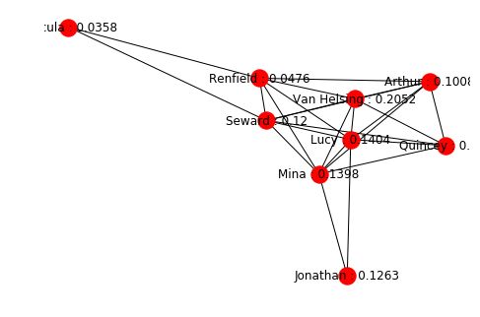
Relationships : Pagerank
Top left is Dracula, and value for Quincey is 0,084.
Dracula is not the main character (rarely appears)
Van helsing has the highest score.
Limitation : In the book Dracula is often referred as different names (« the beast … ») which makes it hard to capture every relation.
Advantages : Fast iterating algorithm that enables us to rank characters.

Slide 10
Frequent itemsets
Goal : identify which characters appear most in every chapter
PREPROCESSING
Dividing the book in chapters, then in sentences, then in words
Keeping only words that were found in a set of character names we assembled :
["count", "dracula", "beast", "vampire", "jonathan", "mina", "murray","arthur", "holwood", "quincey", "morris", "renfield", "john", "seward", "abraham", "helsing", "lucy", "westenra"]
Replacing every one of these character names by a single identifying name (e.g. : "count" -> "Count Dracula")

Slide 11
Frequent itemsets
IMPLEMENTING APRIORI
Parameters :
A list of transactions : sets of names appearing together
An integer minimum support : 5
An integer maximum length of sets : 10
Returns a list of tuples containing two elements : a set of characters, and an integer representing the support of the set

Slide 12
Frequent itemsets
APPLYING THE ALGORITHM
Function that :
Converted character names to codes (for easier conversion into sets)
Applied Apriori on every chapter, and returned a list of traditional Apriori returns
Converted character codes back to strings
Returns : list > chapters > frequent itemsets > names set + support

Slide 13
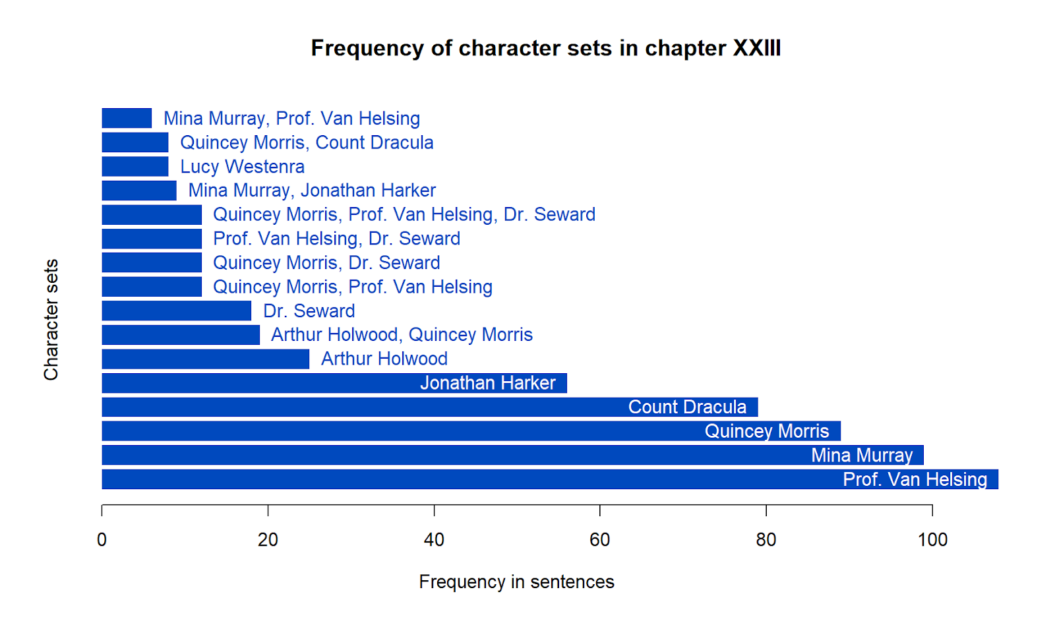
Frequent itemsets
Diaries :
Seward
Harker
Events :
Men fight Dracula
Van Helsing talks with Mina

Slide 14
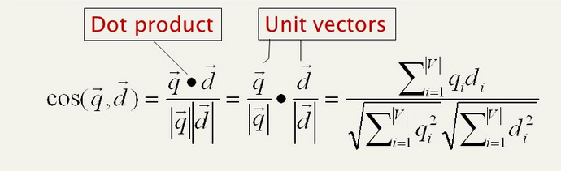
Simplified search engine
Using tf-idf we tried to make a simple search engine for the book.
This can prove very useful in case you havn’t read the book and want to search for specific parts.
Uses tfidf cosines to generate a similarity between query and documents, then return the highest one.

Slide 15
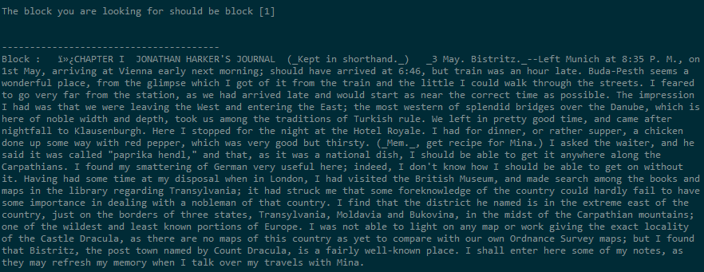
Tf-idf query exemple
"I stopped at hotel royale, we had a good diner and i then visited a museum.“
This is about the very beginning of the book so it should return first block

Slide 16
Conclusion
Dracula = mysterious character, elusive to text mining
“Goal “of the novel : to paint his picture with not many informations
Epistolary style :
It’s hard to find continuty or development because of changing POV
Investigate the novel by diary entries ?
More knowledge of past analysis of Dracula would be helpful

Slide 17
Conclusion
ETHICAL ASPECTS
No concern in this project, but in general natural language processing…
Text on online services (Twitter etc) either:
Easily available
Made vulnerable by security failures
Which can be used to:
Influence customers to buy products
Influence voters and change political landscape
But there are benefits :
More access to technology (ex: voice recognition)
More informational equality (ex: extract information from web)

Slide 18
Thank you for your attention ! :-) Any questions ?

